Slide 1
NBA ROOKIE
Predict 5-Year Career Longevity for NBA Rookies
PRESENTED BY
PRATHAMESH JOSHI

Slide 2
TABLE OF CONTENTS
INTRODUCTION
PROBLEM STATEMENT
ATTRIBUTE INFORMATION
EXPLORATORY DATA ANALYSIS
FEATURE SELECTION
MACHINE LEARNING ALGORITHMS
RESULT
CONCLUSION

Slide 3

INTRODUCTION
NOTE:
To change images on this slide, select a picture and delete it. Then click the Insert Picture icon
in the placeholder to insert your own image.
The National Basketball Association's Rookie of the Year Award is an annual National Basketball Association award given to the top rookie of the regular season. Data should contain 1340 instances and 21 attributes , In the 21 attributes 20 are independent variable and 1 are dependent variable.

Slide 4
PROBLEM STATEMENT & GOAL
Dataset for classification -use NBA rookie stats to predict if player will last 5 years in league ?
Explore data
Check the relation between the variables?
Check any multicolenearity exist ?

Slide 5
ATTRIBUTE INFORMATION
NAME : NAME | FTA : Free Throw Attempt
GP : Game Played | FT% : Free Throw Percent
MIN : Minutes Played | OREB : Offensive Robounds
PTS : Points Per Game | DREB : Defensive Robounds
FGM : Field Goals Made | REB : Rebounds
FGA : Field Goal Attempts | AST : Assist
FG% : Field Goal Percent | STL : Steals
3P MADE : 3 Point Made | BLK : Blocks
3PA : 3 Point Attempts | TOV : Turnovers
3P% : 3 Point Percent | TARGET_5YRS : Outcome 1 or 0
FTM : Free Throw Made

Slide 6
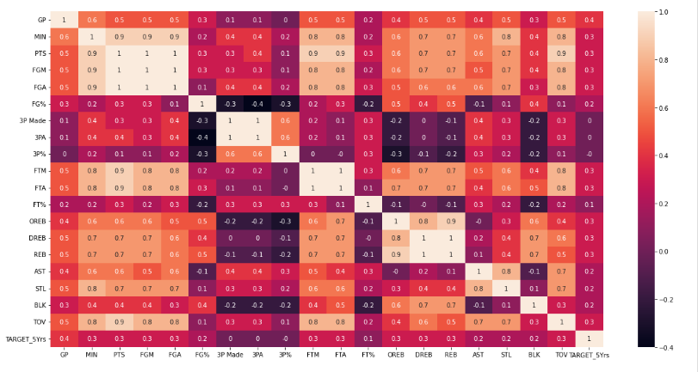
EDA ( Exploratory Data Analysis )

Slide 7
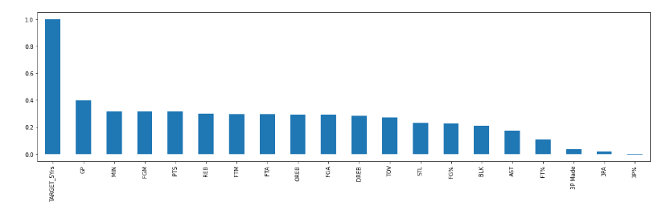
Corelation :

Slide 8
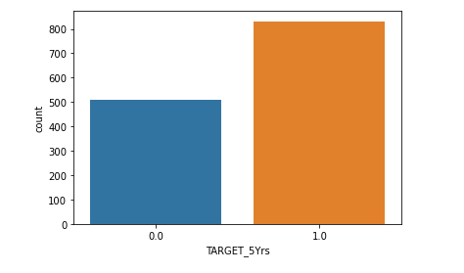
Target variable(Dependent Variable)

Slide 9
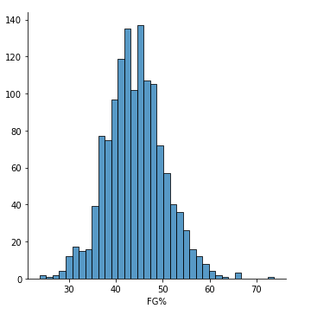
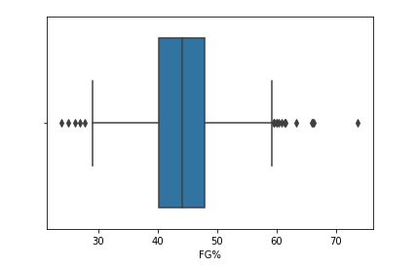
Displot and Boxplot
FG% (Field Goal Percent)

Slide 10
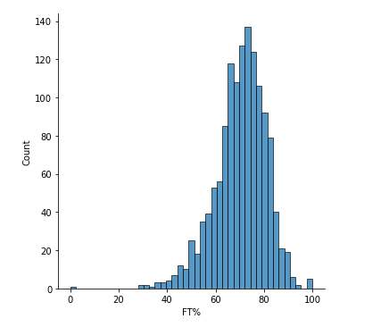
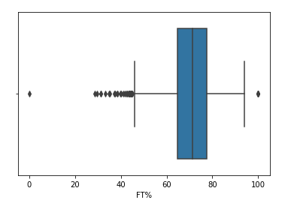
Displot and Boxplot
FT% (Free Throw Percent)

Slide 11
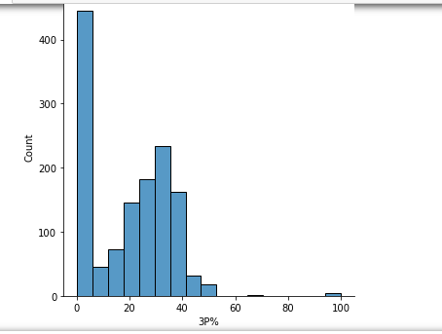
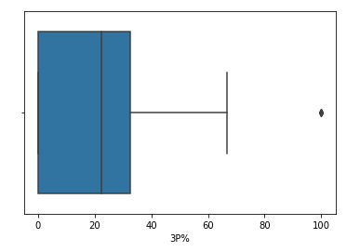
Displot and Boxplot
3P% (3 point percent )

Slide 12
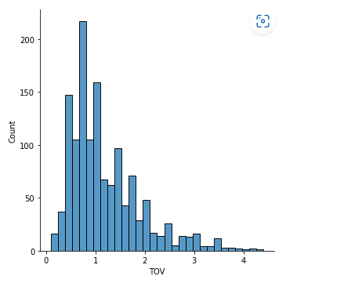
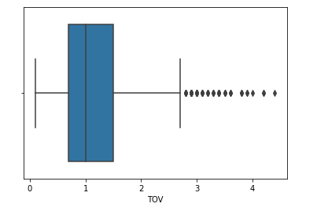
Displot and Boxplot
Tov (Turnover)

Slide 13
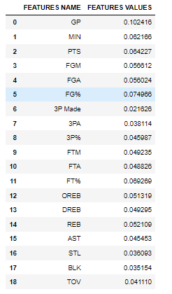
FEATURE IMPOERTANCE
Using the random forest model we see the feature importance of the independent variable.

Slide 14
MACHINE LEARNING ALGORITHMS
LOGISTIC MODEL
RANDOM FOREST
SVM

Slide 15
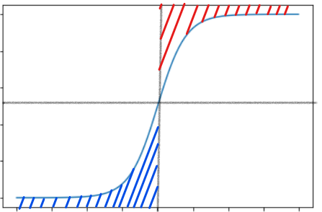
LOGISTIC MODEL
Supervised Algorithm
Sampling
Target variable
class1
1
Predicted
 | 0 | 1
0 | 54 | 45
1 | 26 | 143
Actual
0.5
0
Class 0

Slide 16
RANDOM FOREST
Supervised Algorithm
Sampling
Target variable (Binary and Multiclass)
Hyper Parameter Tuning
Max Depth
N-estimator
criterion
Predicted
 | 0 | 1
0 | 49 | 50
1 | 30 | 139
Actual

Slide 17
SVM (SUPPORT VECTOR MACHINE)
Supervised Algorithm
Sampling
Target variable (Binary)
Hyper Parameter Tuning
Kernals
Predicted
 | 0 | 1
0 | 42 | 57
1 | 18 | 151
Actual

Slide 18
RESULT

Slide 19
CONCLUSION
As we see the above results
in terms of evaluation parameter , accuracy Logistic model gave the better result
In terms of evaluation parameter , tpr also known as Recall , SVM gave better results
In terms of evaluation parameter , Precision, Logistic model gave better results
In terms of evaluation parameter f1 ratio also known as harmonic mean between recall and precision Logistic model gave better results
Logistic regression model fit for the prediction NBA Rookie longevity for next 5 years

